Slide 1
Introduction to Components

Slide 2


Slide 3

What is a component?
Creating the component class
Module Overview
Defining the metadata with a decorator
Importing what we need Bootstrapping our app component
Something’s wrong!

Slide 4
Application Architecture
Welcome Component
index.html
App Component
Product List Component
Star Component
Product Detail Component
Product Data Service

Slide 5


What Is a Component?
Class
Component
=
Template
+
Properties
+
Metadata
Methods
View layout
Created with HTML
Includes binding and directives
Code supporting the view
Created with TypeScript
Properties: data
Methods: logic
Extra data for Angular
Defined with a decorator

Slide 6
Component
Import
app.component.ts
import { Component } from '@angular/core';
@Component({
selector: 'pm-root',
template: `
<div><h1>{{pageTitle}}</h1>
<div>My First Component</div>
</div>
`
Metadata & Template
})
Class
export class AppComponent {
pageTitle: string = 'Acme Product Management';
}

Slide 7
Creating the Component Class
app.component.ts
export class AppComponent {
pageTitle: string = 'Acme Product Management';
}
class
keyword
Class Name
export
keyword
Component Name when used in code

Slide 8
Creating the Component Class
app.component.ts
export class AppComponent {
pageTitle: string = 'Acme Product Management';
}
Data Type
Default Value
Property Name
Methods

Slide 9
Defining the Metadata
app.component.ts
@Component({
selector: 'pm-root', template: `
<div><h1>{{pageTitle}}</h1>
<div>My First Component</div>
</div>
`
})
export class AppComponent {
pageTitle: string = 'Acme Product Management';
}

Slide 10
Decorator
A function that adds metadata to a class, its members, or its method arguments.
Prefixed with an @.
Angular provides built-in decorators.
@Component()

Slide 11
Defining the Metadata
app.component.ts
Component decorator
@Component({
selector: 'pm-root',
template: `
Directive Name used in HTML
<div><h1>{{pageTitle}}</h1>
<div>My First Component</div>
</div>
`
View Layout
})
export class AppComponent {
pageTitle: string = 'Acme Product Management';
}
Binding

Slide 12

Importing What We Need
Before we use an external function or class, we define where to find it
import statement
Allows us to use exported members from:
Other files in our application
Angular framework
External JavaScript libraries

Slide 13
Importing What We Need
app.component.ts
@Component({
selector: 'pm-root', template: `
<div><h1>{{pageTitle}}</h1>
<div>My First Component</div>
</div>
`
})
export class AppComponent {
pageTitle: string = 'Acme Product Management';
}

Slide 14
Importing What We Need
app.component.ts
import keyword
import { Component } from '@angular/core';
@Component({
selector: 'pm-root', template: `
<div><h1>{{pageTitle}}</h1>
<div>My First Component</div>
</div>
`
})
export class AppComponent {
pageTitle: string = 'Acme Product Management';
}
Angular library name
Member name

Slide 15
Completed Component
app.component.ts
import { Component } from '@angular/core';
@Component({
selector: 'pm-root', template: `
<div><h1>{{pageTitle}}</h1>
<div>My First Component</div>
</div>
`
})
export class AppComponent {
pageTitle: string = 'Acme Product Management';
}

Slide 16
Demo
Creating the App component

Slide 17

Bootstrapping Our App Component
Host the application
Defining the Angular module

Slide 18



Web Server
Web Browser
URL Request (www.mysite.com)
Response
index.html
JavaScript

Slide 19

Single Page Application (SPA)
index.html contains the main page for the application
This is often the only Web page of the application
Hence an Angular application is often called a Single Page Application (SPA)

Slide 20
Hosting the Application
index.html
app.component.ts
<body>
<pm-root></pm-root>
</body>
import { Component } from '@angular/core';
@Component({
selector: 'pm-root',
template: `
<div><h1>{{pageTitle}}</h1>
<div>My First Component</div>
</div>
`
})
export class AppComponent {
pageTitle: string = 'Acme Product Management';
}

Slide 21
Organization Boundaries
BrowserModule
AppModule
Template resolution environment
AppComponent
Imports Exports Declarations Bootstrap

Slide 22
Defining the Angular Module
app.module.ts
import { NgModule } from '@angular/core';
import { BrowserModule } from '@angular/platform-browser'; import { AppComponent } from './app.component';
@NgModule({
imports: [ BrowserModule ],
declarations: [ AppComponent ], bootstrap: [ AppComponent ]
})
export class AppModule { }

Slide 23
Demo
Bootstrapping our App component

Slide 24
Angular compiles our HTML templates and TypeScript components to JavaScript

Slide 25
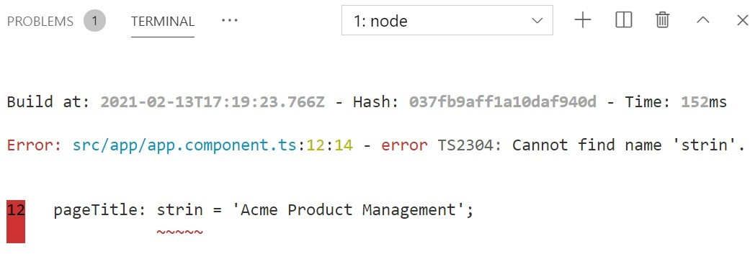
Something’s Wrong!
@NgModule({
declarations: [ AppComponent,
ProductListComponent
],
imports: […], bootstrap: […]
})
export class AppModule { }
export class AppComponent { pageTitle = 'Acme PM'; PageTitle = 'Something else';
}
Compiler displays syntax errors
Casing matters
Components must be declared in an Angular module

Slide 26
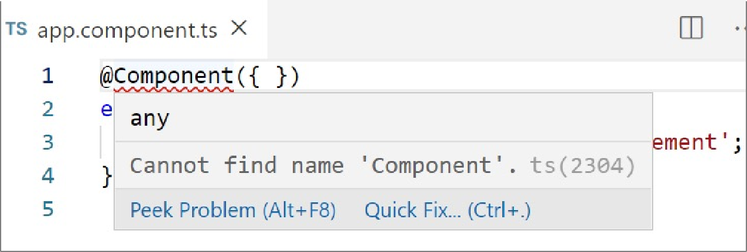
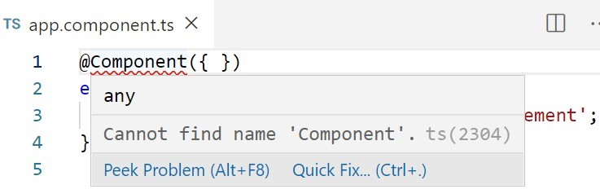
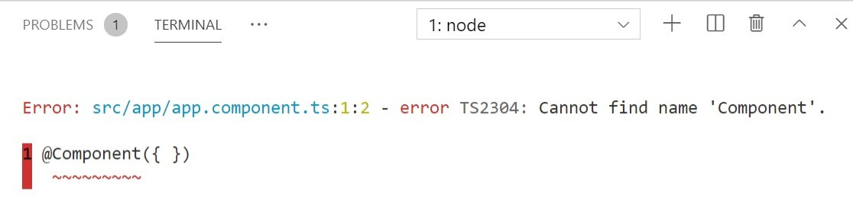
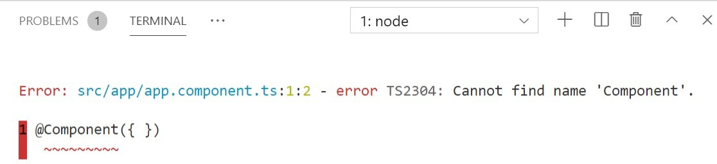
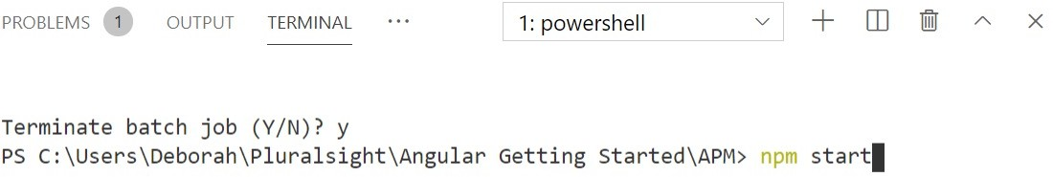
Start with Your Code Editor
Check for squiggly lines
Open the terminal
Stop (Ctrl+C) and Restart

Slide 27
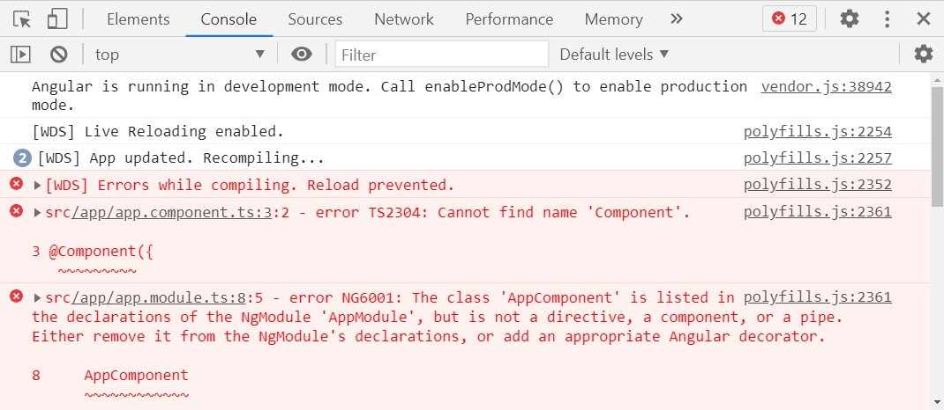
Use the browser’s developer tools

Slide 28
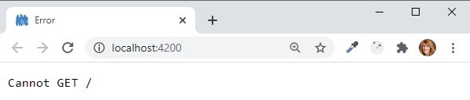
Often means an error prevented the compiler from completing
Use the VS Code terminal to view the errors

Slide 29

Recheck Your Code
HTML
Close tags
Angular directives are case sensitive
TypeScript
Close braces
TypeScript is case sensitive

Slide 30

Component Checklist
Class -> Code
Decorator -> Template and Metadata Import what we need

Slide 31
Component Checklist: Class
Clear name
Use PascalCasing
Append "Component" to the name
export keyword
export class AppComponent {
pageTitle: string = 'Acme Product Management’;
}

Slide 32
Component Checklist: Members
Data in properties
Appropriate data type
Appropriate default value
camelCase with first letter lowercase
Logic in methods
camelCase with first letter lowercase
export class AppComponent {
showImage: boolean =
false;
toggleImage(): void { this.showImage = true;
}
// property
// method
}

Slide 33
Component Checklist: Metadata
Component decorator
Prefix with @; Suffix with ()
selector: Component name in HTML
Prefix for clarity
template: View's HTML
Correct HTML syntax
@Component({
selector: 'pm-root', template: `
<div><h1>{{pageTitle}}</h1></div>
`
})

Slide 34
Component Checklist: Import Statement
Defines where to find the members that this component needs
import keyword Member name
Correct spelling/casing
Path
Enclose in quotes
Correct spelling/casing
import { Component } from '@angular/core';

Slide 35
Application Architecture
Welcome Component
index.html
App Component
Product List Component
Star Component
Product Detail Component
Product Data Service

Slide 36

Coming up next …
Templates, Interpolation, and Directives

